Slide 1

Employee Attrition Prediction Using Machine Learning Algorithm
Mr.Rajat Singh – 22MCA0139
Mr. Hrishikesh S G – 22MCA0162
Guide - Prof. Ephzibah E. P

Slide 2
Abstract
Machine Learning is a branch of artificial intelligence that leverages data to imitate the pattern by which a human brain learns, in the process improving accuracy. Statistical principles are used to process data and learn from it efficiently. Machine Learning algorithms are extensively used to predict future outcomes based on past experiences that were recorded in a meticulous manner. These past experiences or data can help us to deduce preliminary insights about the data and what it represents. The current paper discusses certain Machine Learning algorithms where the prime objective is to classify the inputs into one of the two categories. The dataset in focus is the employee attrition dataset that gives various insights regarding the presumably reasons behind an employee leaving the job. The factors such as accuracy, precision score, recall score and f1_score for Random Forest, XGBoost, Adaboost, Gradient boosting and Decision Tree Classifier have been ascertained and compared. Furthermore, Hyperparameter tuning, using the ‘RandomSearchCV’ python library is also implemented on the better performing algorithms, with the goal of achieving better performance.
Keywords: Machine Learning, Random Forest, XGBoost, Adaboost, Decision Tree, Gradient Boost, Hyperparameters, RandomSearchCV.
Notes:
Aim : to prepare the model which predicts that employee will leave the company or not
What is employee attrition
Employee attrition, also known as employee turnover or employee churn, refers to the rate at which employees leave an organization over a specific period of time.
Attrition can occur due to various reasons
finding better job opportunities, dissatisfaction with the work environment, lack of career growth or development opportunities, personal reasons, retirement, or termination.
Why(reason to do)?
Alarming thing for company, time/money invested in emoloyee, very good employee

Slide 3
Contents
Previous work
Hyperparameter Tuning
Hyperparameter working
Performance measures used
Algorithms used
Results
Future work
References

Slide 4
Previous work
A number of papers pertaining to this topic was reviewed. All of these papers predicted the employee attrition fairly well. Some of the methods used for prediction involved Naive bayes and others involved complex modules such as tensor flow.
However, a pattern was noticed in all these papers, the number of constraints used to train the model well less, making the model no very strong for complex scenarios. We have used over 30 attributes from our data set that we downloaded from kaggle.
To make our project unique, we added an extra step at the end of prediction. This step involves hyperparameter tuning the models and predicting again.
The attributes used for our research are also deeply related with the factors of an employee leaving a company which was not the case in other papers.

Slide 5
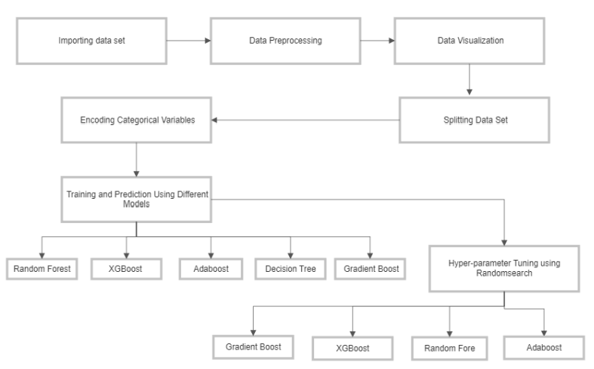
Flow Chart
Notes:
Encoding Categorical values :
One hot :
department educationfield job role,
Ordinal encoding : education level,etc

Slide 6
Hyperparameter Tuning
Hyperparameters contain the data that govern the training process itself.
Your training application handles three categories of data as it trains your model:
Your input data (also called training data) is a collection of individual records (instances) containing the features important to your machine learning problem. This data is used during training to configure your model to accurately make predictions about new instances of similar data. However, the values in your input data never directly become part of your model.
Your model's parameters are the variables that your chosen machine learning technique uses to adjust to your data.
Your hyperparameters are the variables that govern the training process itself.

Slide 7
Hyperparameter Working
Hyperparameter tuning works by running multiple trials in a single training job. Each trial is a complete execution of your training application with values for your chosen hyperparameters, set within limits you specify.
The AI Platform Training training service keeps track of the results of each trial and makes adjustments for subsequent trials. When the job is finished, you can get a summary of all the trials along with the most effective configuration of values according to the criteria you specify.

Slide 8
Performance Measures Used
Accuracy: Accuracy represents the number of correctly classified data instances over the total number of data instances.
Precision: the number of true positives divided by the number of true positives plus the number of false positives. False positives are cases the model incorrectly labels as positive that are actually negative.
Recall: expresses the ability to find all relevant instances of a class in a data set.
F1_Score: The F1 score is the harmonic mean of precision and recall.

Slide 9
Algorithms Used
Random Forest
XGBoost
Adaboost
Decision Tree
Gradient Boost

Slide 10
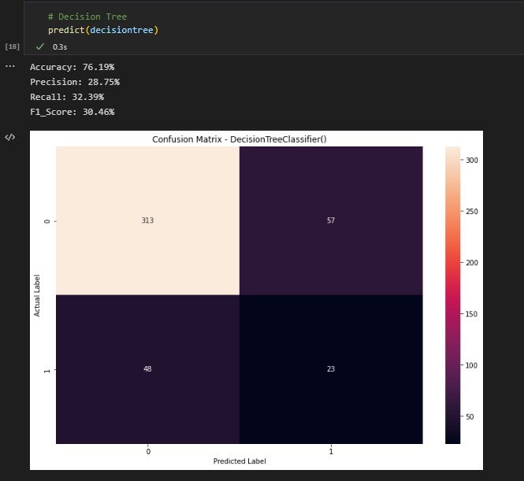
Decision Tree

Slide 11
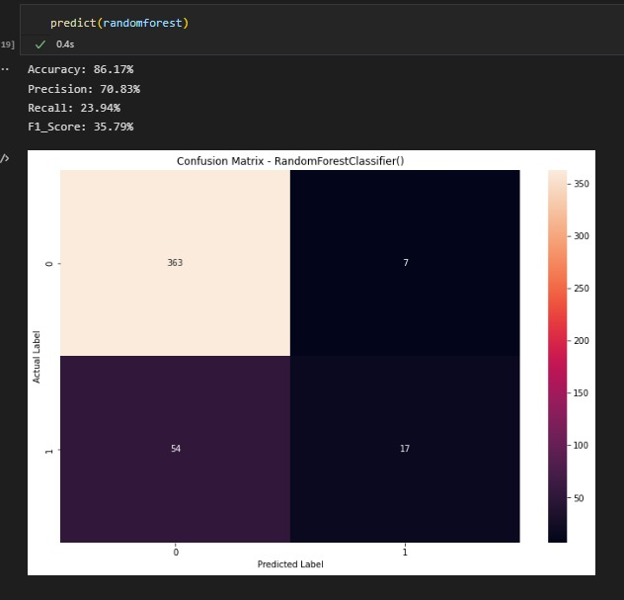
Random Forest

Slide 12
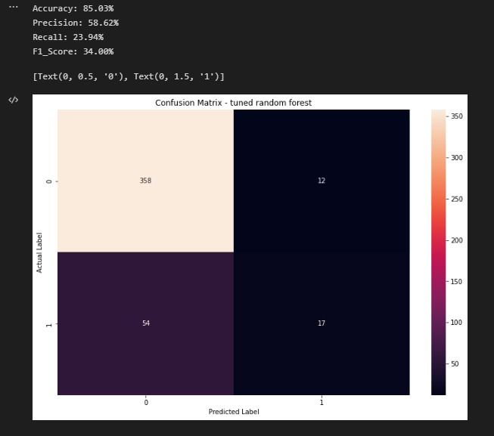
Random Forest
(with Hyperparameter tuning)

Slide 13
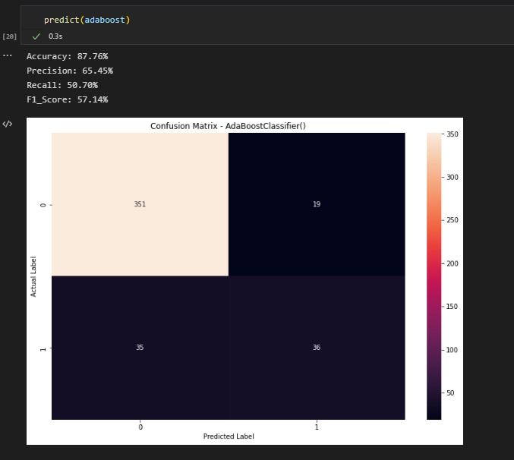
Adaboost

Slide 14
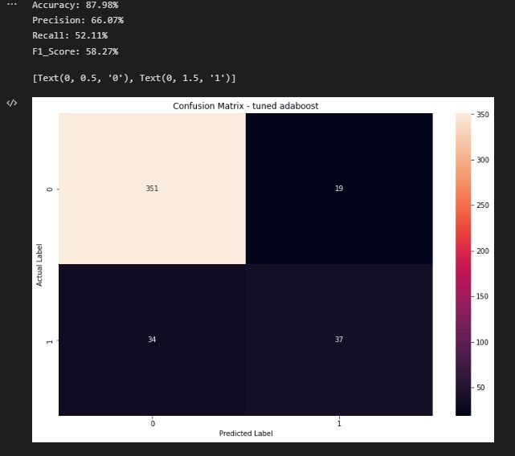
Adaboost
(with Hyperparameter tuning)

Slide 15
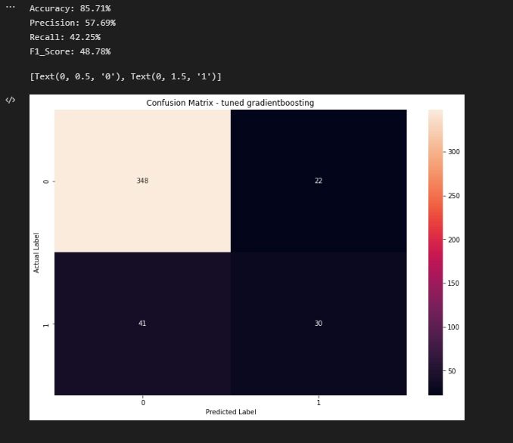
Gradient Boost

Slide 16
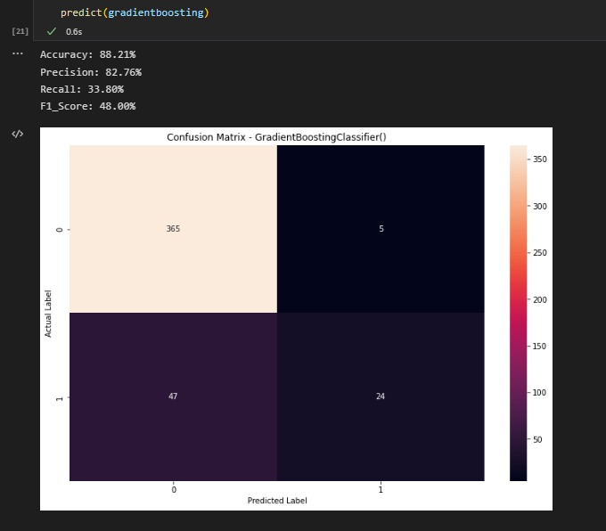
Gradient Boost
(with Hyperparameter tuning)

Slide 17
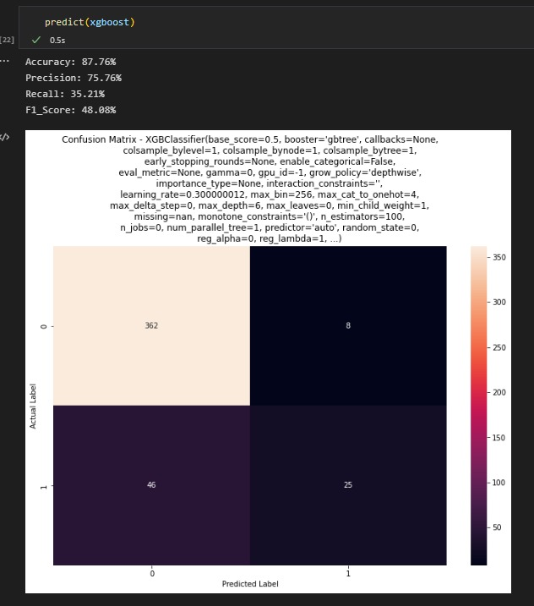
XGBoost

Slide 18
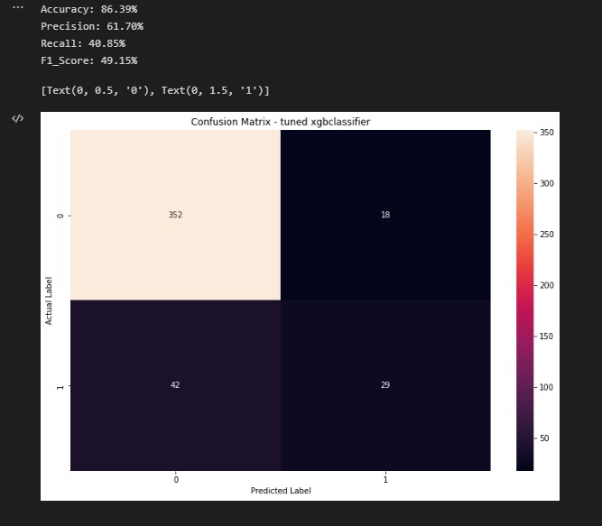
XGBoost
(with Hyperparameter tuning)

Slide 19
Conclusion
High staff turnover rate is a big issue for any organisation.
When a high-performance employee leaves the company, it is very difficult to find a replacement for that employee. I
f that employee was high performing, that means a lot of resources had been invested in his/her training.
To replace such an employee, this cycle must be performed again which makes if very inefficient.
The main goal of this research is to train the different ML models and evaluate their performances.
The comparison of performances of different models is also essential.
According to the recorded results, Ada-boost is the best performing model as it has the best recall score at 52.11% after hyperparameter tuning.
In the future, data to be trained to the model should be from a company that works in a totally different field. Furthermore, the possibility of practical utilization of these models should be explored extensively.
Notes:
The findings of this study demonstrate that algorithms for data extraction can be used to create precise and trustworthy models for employee attrition forecasting.

Slide 20
Future Work
This study can be extended by using more sophisticated machine learning algorithms such as neural networks and deep learning to analyze the data. Furthermore, the study can be extended to include other factors that may influence employee attrition such as work-life balance, company culture, and company's financial stability.

Slide 21
References
[1] Shankar, R.S., Rajanikanth, J., Sivaramaraju, V.V. and Murthy, K.V.S.S.R., 2018, July. Prediction of employee attrition using datamining. In 2018 ieee international conference on system, computation, automation and networking (icscan) (pp. 1-8). IEEE.
[2] Alao, D.A.B.A. and Adeyemo, A.B., 2013. Analyzing employee attrition using decision tree algorithms. Computing, Information Systems, Development Informatics and Allied Research Journal, 4(1), pp.17-28.
[3] Alduayj, S.S. and Rajpoot, K., 2018, November. Predicting employee attrition using machine learning. In 2018 international conference on innovations in information technology (iit) (pp. 93-98). IEEE.
[4] Fallucchi, F., Coladangelo, M., Giuliano, R. and William De Luca, E., 2020. Predicting employee attrition using machine learning techniques. Computers, 9(4), p.86.
[5] Martin, L., 2020. How to retain motivated employees in their jobs?. Economic and Industrial Democracy, 41(4), pp.910-953.
[6] Jhaveri, S., Khedkar, I., Kantharia, Y. and Jaswal, S., 2019, March. Success prediction using random forest, catboost, xgboost and adaboost for kickstarter campaigns. In 2019 3rd International Conference on Computing Methodologies and Communication (ICCMC) (pp. 1170-1173). IEEE.
[7] Kabiraj, S., Raihan, M., Alvi, N., Afrin, M., Akter, L., Sohagi, S.A. and Podder, E., 2020, July. Breast cancer risk prediction using XGBoost and random forest algorithm. In 2020 11th international conference on computing, communication and networking technologies (ICCCNT) (pp. 1-4). IEEE.
[8] Bardenet, R., Brendel, M., Kégl, B. and Sebag, M., 2013, May. Collaborative hyperparameter tuning. In International conference on machine learning (pp. 199-207). PMLR.
[9] Schratz, P., Muenchow, J., Iturritxa, E., Richter, J. and Brenning, A., 2019. Hyperparameter tuning and performance assessment of statistical and machine-learning algorithms using spatial data. Ecological Modelling, 406, pp.109-120.
[10] Shi, X., Wong, Y.D., Li, M.Z.F., Palanisamy, C. and Chai, C., 2019. A feature learning approach based on XGBoost for driving assessment and risk prediction. Accident Analysis & Prevention, 129, pp.170-179.

Slide 22
[11]Alhashmi, S.M., 2019, November. Towards Understanding Employee Attrition using a Decision Tree Approach. In 2019 International Conference on Digitization (ICD) (pp. 44-47). IEEE.
[12]Sisodia, D.S., Vishwakarma, S. and Pujahari, A., 2017, November. Evaluation of machine learning models for employee churn prediction. In 2017 international conference on inventive computing and informatics (icici) (pp. 1016-1020). IEEE.
[13]Hebbar, A.R., Patil, S.H., Rajeshwari, S.B. and Saqquaf, S.S.M., 2018, May. Comparison of machine learning techniques to predict the attrition rate of the employees. In 2018 3rd IEEE International Conference on Recent Trends in Electronics, Information & Communication Technology (RTEICT) (pp. 934-938). IEEE.
[14]Dubey, R. and Bisht, G., 2009, April. Key Result Employee (KRE) Retention:" Entrapping the Mammoth". In 2009 International Association of Computer Science and Information Technology-Spring Conference (pp. 272-275). IEEE.
[15]Brockett, N., Clarke, C., Berlingerio, M. and Dutta, S., 2019, December. A system for analysis and remediation of attrition. In 2019 IEEE International Conference on Big Data (Big Data) (pp. 2016-2019). IEEE.
[16]Singh, M., Varshney, K.R., Wang, J., Mojsilovic, A., Gill, A.R., Faur, P.I. and Ezry, R., 2012, December. An analytics approach for proactively combating voluntary attrition of employees. In 2012 IEEE 12th International Conference on Data Mining Workshops (pp. 317-323). IEEE.
[17]Joseph, R., Udupa, S., Jangale, S., Kotkar, K. and Pawar, P., 2021, May. Employee Attrition Using Machine Learning And Depression Analysis. In 2021 5th International Conference on Intelligent Computing and Control Systems (ICICCS) (pp. 1000-1005). IEEE.
[18]Jain, R. and Nayyar, A., 2018, November. Predicting employee attrition using xgboost machine learning approach. In 2018 international conference on system modeling & advancement in research trends (smart) (pp. 113-120). IEEE.
[19]Mhatre, A., Mahalingam, A., Narayanan, M., Nair, A. and Jaju, S., 2020, December. Predicting employee attrition along with identifying high risk employees using big data and machine learning. In 2020 2nd international conference on advances in computing, communication control and networking (icacccn) (pp. 269-276). IEEE.
[20]Alduayj, S.S. and Rajpoot, K., 2018, November. Predicting employee attrition using machine learning. In 2018 international conference on innovations in information technology (iit) (pp. 93-98). IEEE.

